Slide 1
Integrated Project Data Science Development of an autocorrection system of bank checks

Slide 2






Our team
Youssef MANSOUR
Molka MRAD
Houssem OUERDIANE
Dhia BEN AMOR
Haithem GHARBI
Aicha CHAABA

Slide 3
Table of contents
01.
02.
03.
Introduction
Buisness Objectives
Data Science Objectives
04.
05.
Data Preparation
Conclusion

Slide 4
Introduction
01

Slide 5
Business Objectives
02

Slide 6
Achieve the autocorrection of the amount in a check
Manipulate a huge amount of data
Assure the security in the whole process

Slide 7
Detection of the different parts of the check
Comparison between the amount in numbers and the amount in letters
Verifying the validity of the date (the check expires after 3 years and a week)

Slide 8
Check the existence of the signature and its validity
Identify the language written in the check
Identify different handwritings

Slide 9
Data Science Objectives
03

Slide 10
Computer Vision
NLP
CNN
RNN

Slide 11
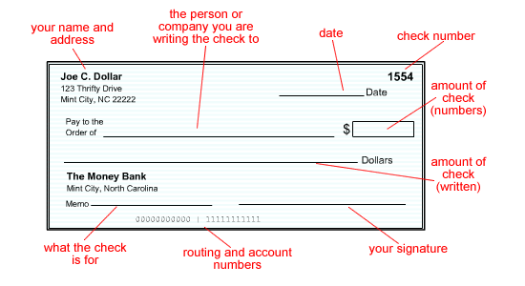
Computer Vision
Preprocessing
Segmentation
To perform image processing on digital images
To improve the image data (features) by suppressing unwanted distortions and/or enchancement of some important image features
Capturing the components of a scanned bank check image

Slide 12
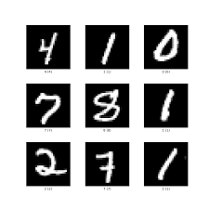
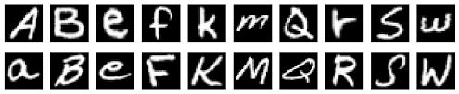
Convolutional Neural Network (CNN)
Identifying the digits from courtesy amount image segment and characters from legal amount segment using CNN EMNIST dataset for Latin letters and MNIST dataset for numbers

Slide 13
Natural Language Processing NLP
NLP is the field of Artificial Intelligence that relates lingual to Computer Science, in which we will :
Identify mispekked words
Find distance away
Filtering
Calculate probabilities of words

Slide 14
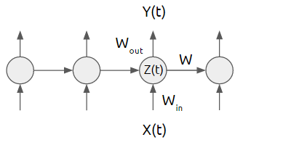
Recurrent Neural Network (RNN)
To extract the handwritten amount in letters from the check, we will be using RNN (Recurrent Neural Network) to predict the multipe handwritten numbers and add them to our database.

Slide 15
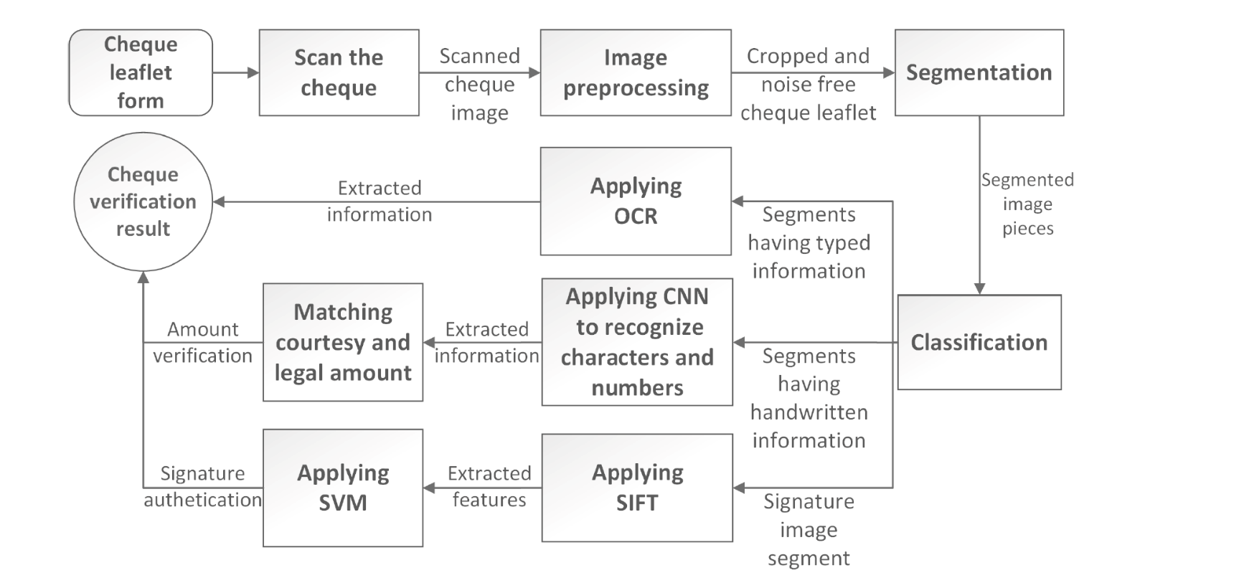

To conclude it all

Slide 16
Data Preperation
04

Slide 17
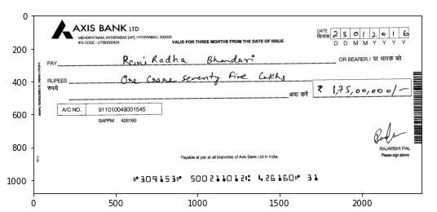
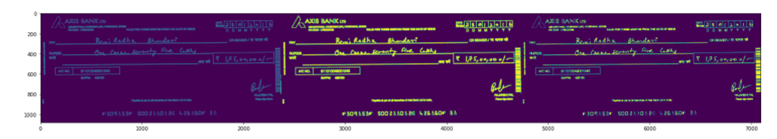
Data Preprocessing
In this part , we applied different filters to our check images to get the best quality for a better prediction.

Slide 18
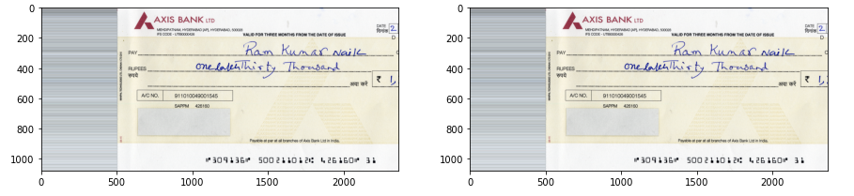
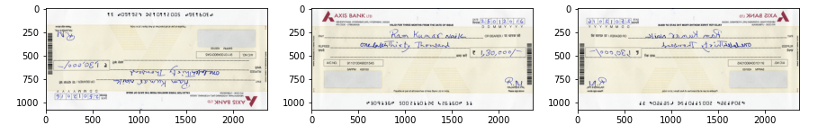
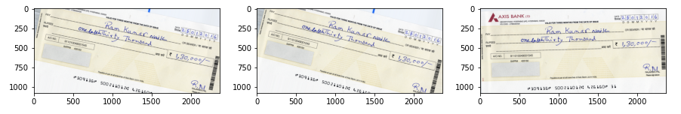
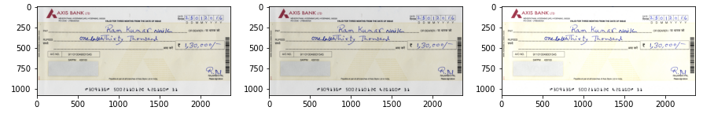
Data Augmentation
Since we have a small dataset, we applied data augmentation to get a better dataset.
We used diffrent methods such as flipping, scrolling, rotation & brightness.

Slide 19
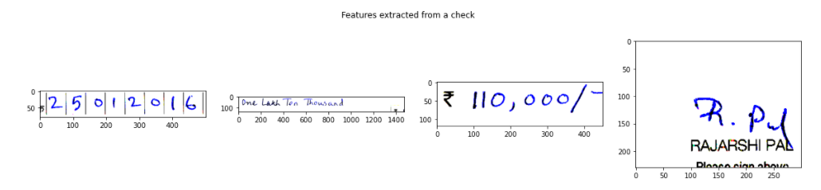
Data Segmentation
In data segmentation , we cropped diffrent parts of the check , mainly the amount in letters and the amount in numbers on which we will apply on them a bounding box to extract the handwritten text and numbers.

Slide 20
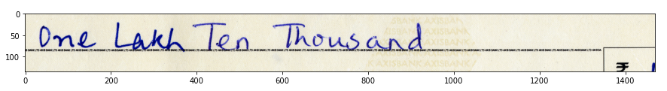
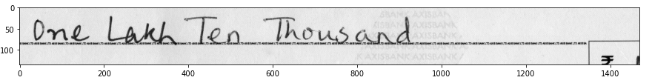
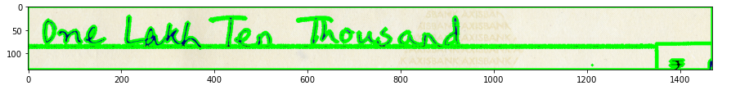
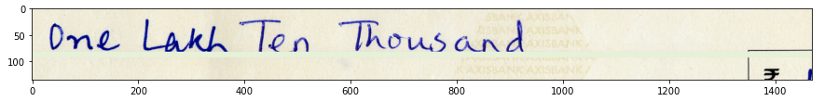
Data Segmentation

Slide 21
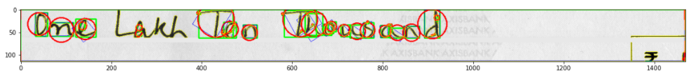
Data Segmentation

Slide 22
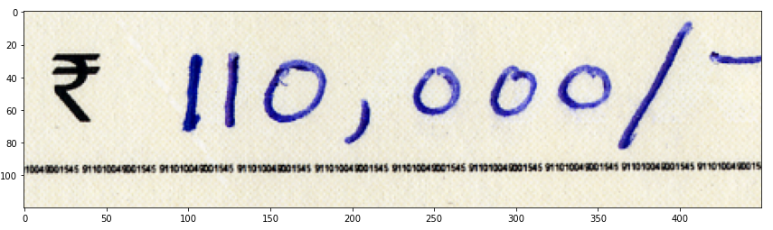
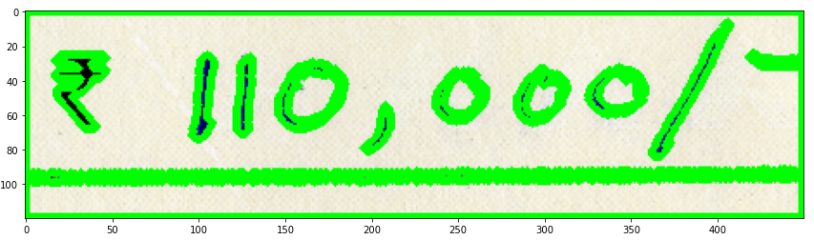
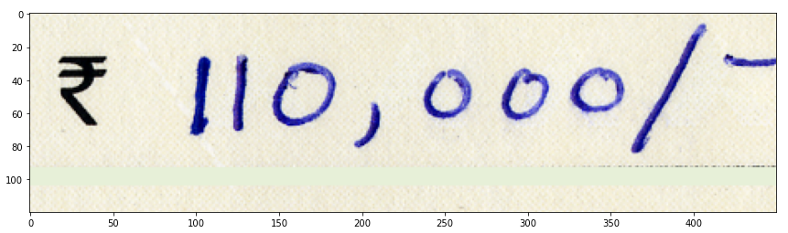
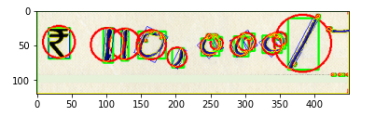
Data Segmentation

Slide 23
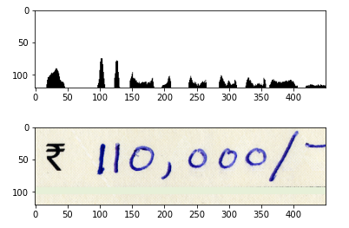
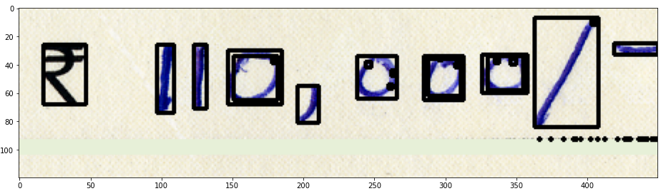
Data Segmentation

Slide 24
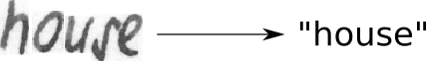
Prediction with SimpleHTR
Handwritten Text Recognition (HTR) system implemented with TensorFlow (TF) and trained on the IAM off-line HTR dataset. This Neural Network (NN) model recognizes the text contained in the images of segmented words as shown in the illustration below. As these word-images are smaller than images of complete text-lines, the NN can be kept small and training on the CPU is feasible. 3/4 of the words from the validation-set are correctly recognized and the character error rate is around 10%.

Slide 25
Prediction with SimpleHTR
About the model :
The implementation only depends on numpy, cv2 and tensorflow imports. It consists of 5 CNN layers, 2 RNN (LSTM) layers and the CTC loss and decoding layer. The illustration below gives an overview of the NN (green: operations, pink: data flowing through NN) and here follows a short description:
-The input image is a gray-value image and has a size of 128x32
-5 CNN layers map the input image to a feature sequence of size 32x256
-2 LSTM layers with 256 units propagate information through the sequence and map the sequence to a matrix of size 32x80. Each matrix-element represents a score for one of the 80 characters at one of the 32 time-steps
-The CTC layer either calculates the loss value given the matrix and the ground-truth text (when training), or it decodes the matrix to the final text with best path decoding or beam search decoding (when inferring)
-Batch size is set to 50

Slide 26
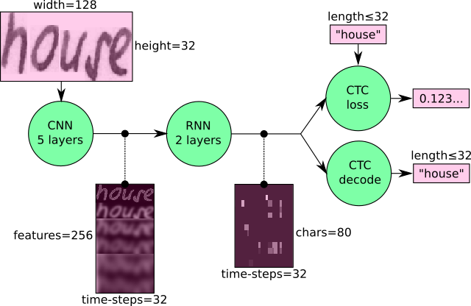
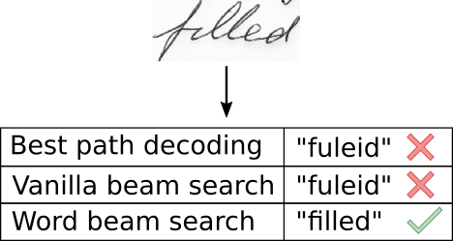
Prediction with SimpleHTR
Overview :

Slide 27
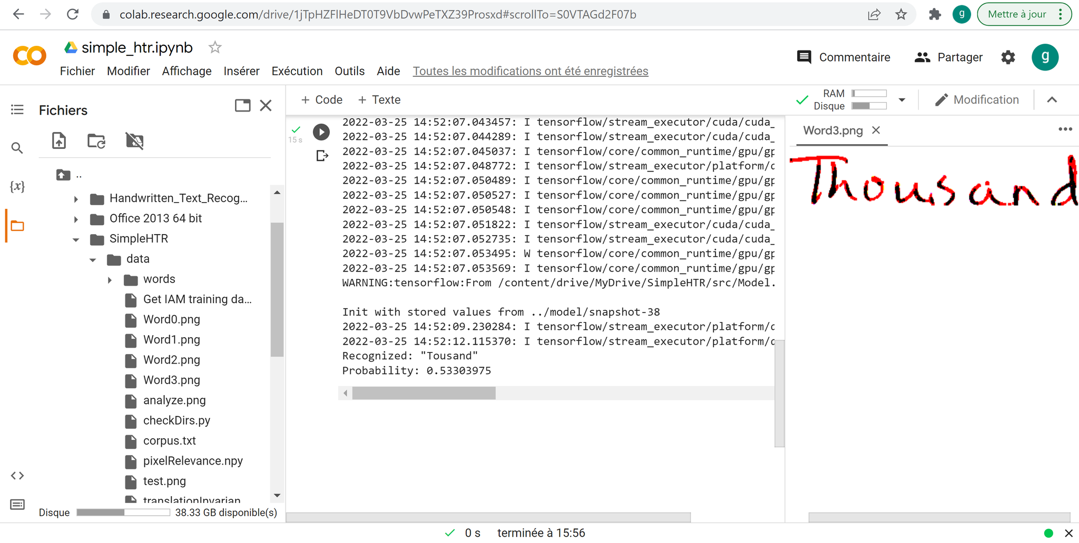
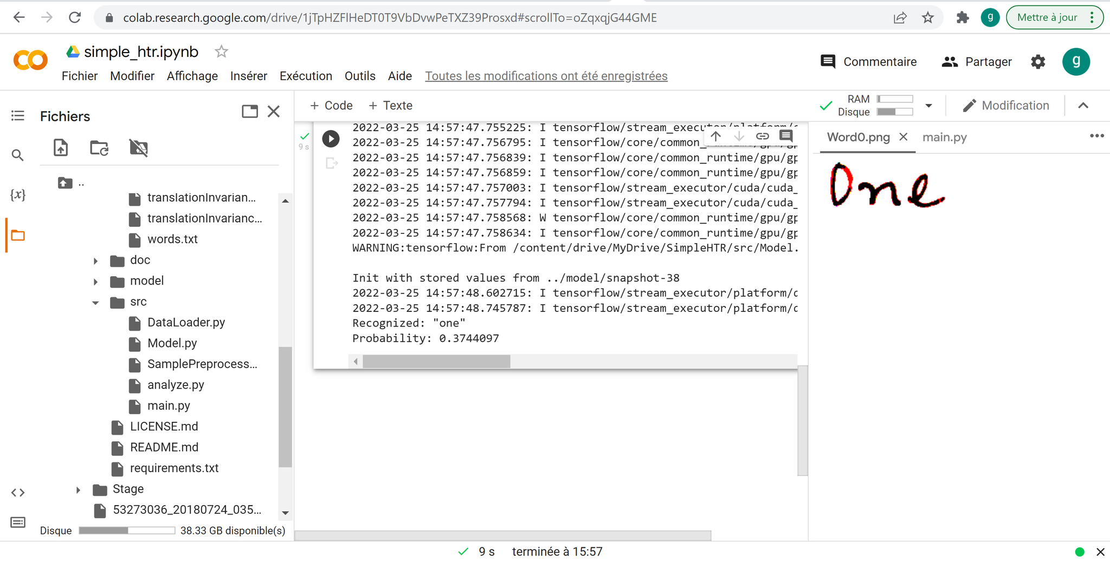
Prediction with SimpleHTR

Slide 28
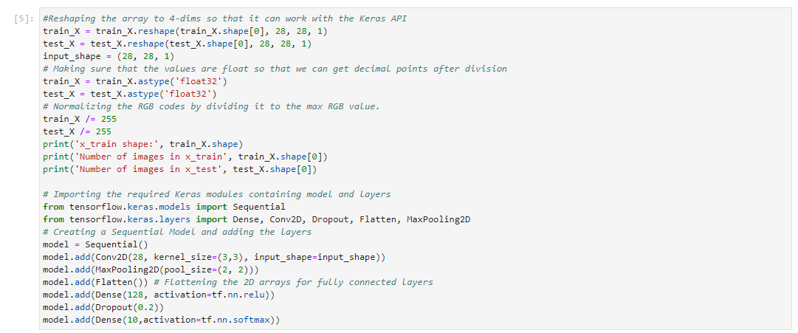
Digits Prediction
First Step: The structure of a convolutional neural network (CNN)

Slide 29
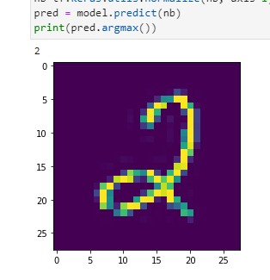
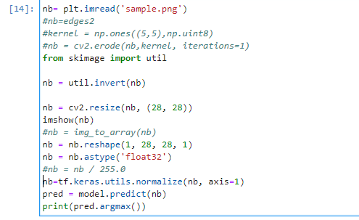
Digits Prediction
Second Step: After some preprocessing of the image to make it look like the MNIST image, we applied the CNN to predict the value of the numbers after segmentation.

Slide 30
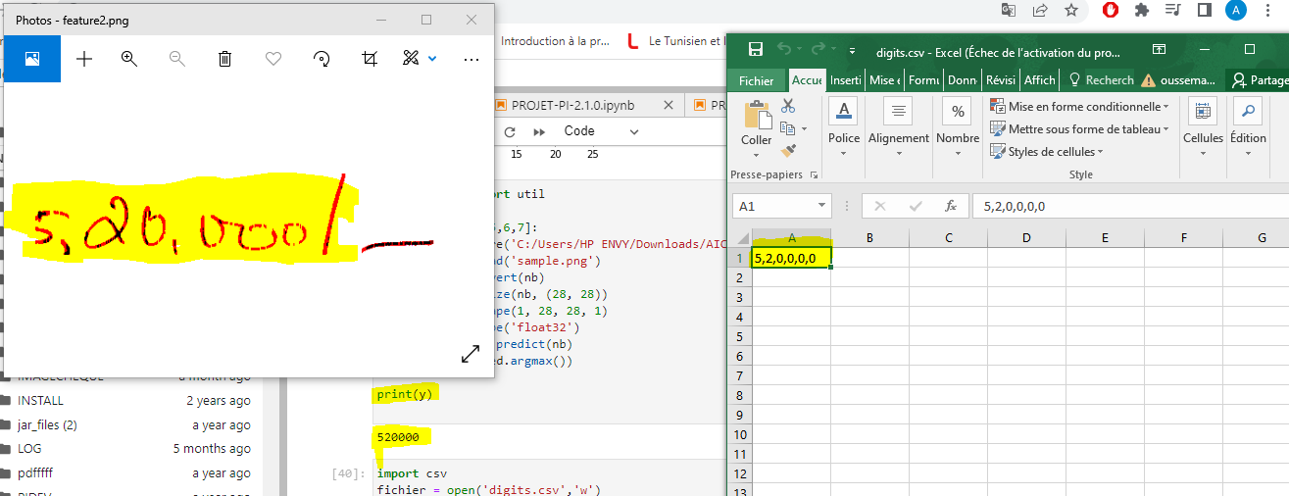
Digits Prediction
Third Step: Concatenation of the different numbers of the numeric amount and save it as an Excel File.

Slide 31
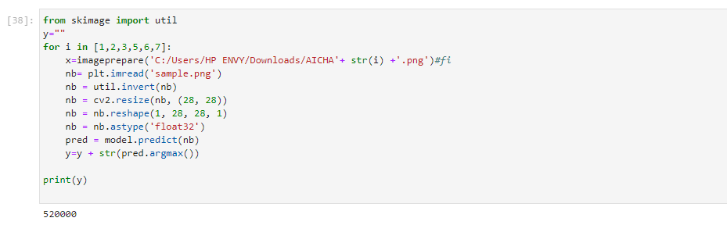
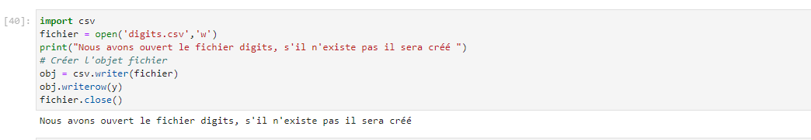
Digits Prediction

Slide 32
Conclusion
05

Slide 33
Thanks!
Do you have any questions?

